Slide 1

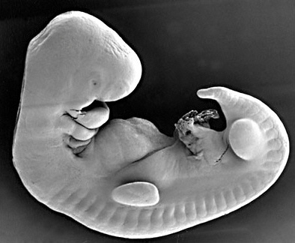
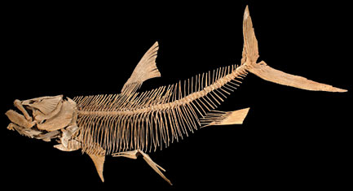
Vertebrata
These animals have a true vertebral column and internal skeleton
Allowing a completely different distribution of muscle attachment points to be used for movement.
Vertebrates are bilaterally
symmetrical,
triploblastic,
coelomic
and segmented with complex differentiation of body tissue and organs.
All chordates possess the following features
Notochord
A dorsal nerve cord
Triploblastic
Paired grill pouches
of or on the back of the body
Coelomate
Showing body cavity or coelom

Slide 2
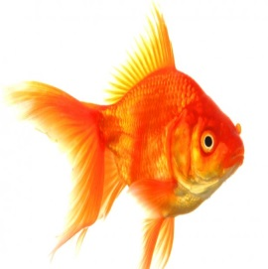
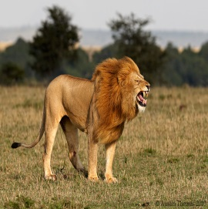
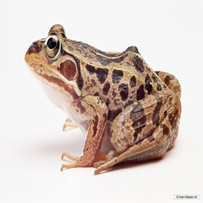
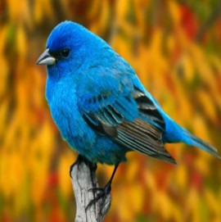
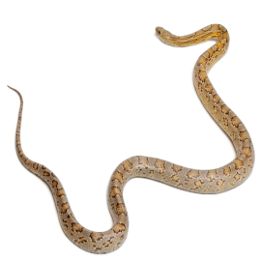
Vertebrates are grouped into five classes
Vertebrates
Pisces
Mammalia
Amphibia
Aves
Reptilia

Slide 3
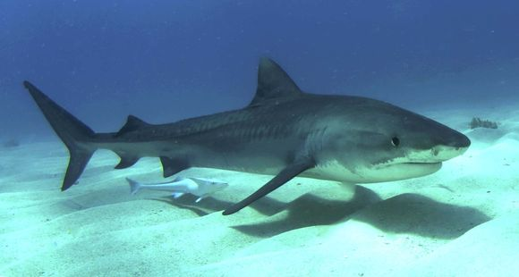
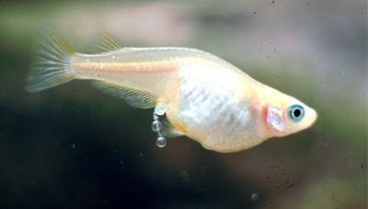

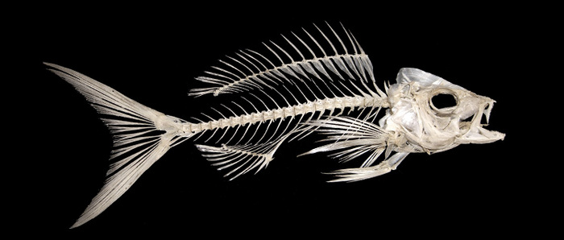
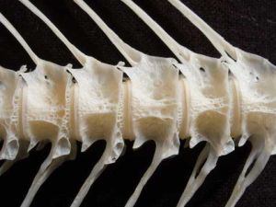
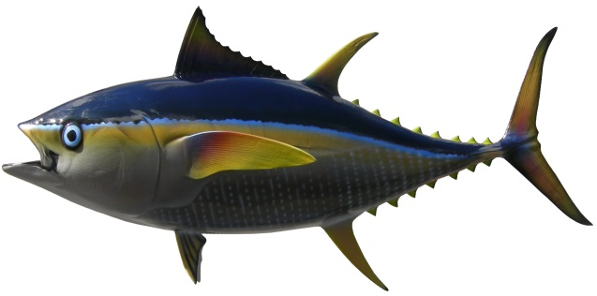
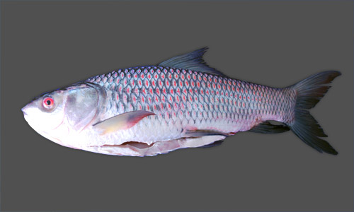
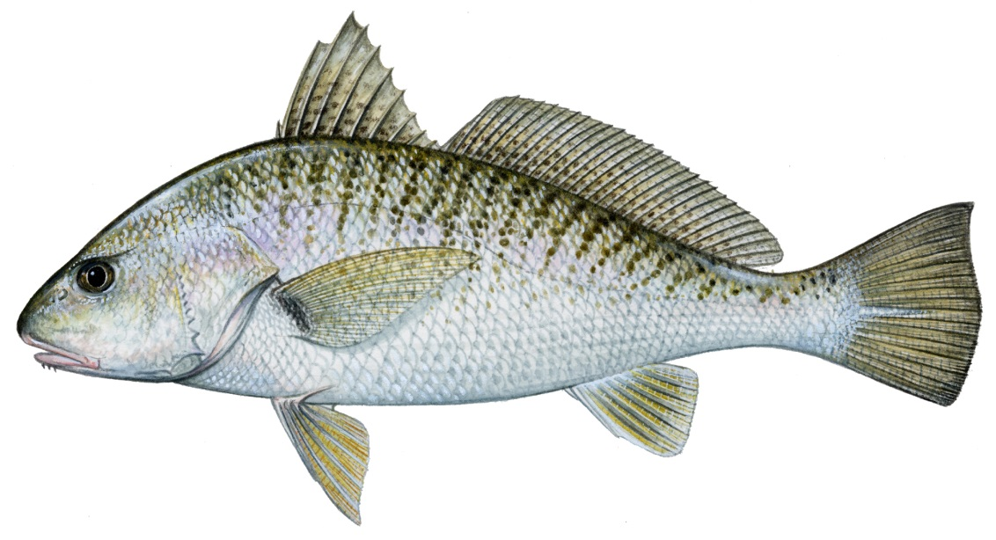
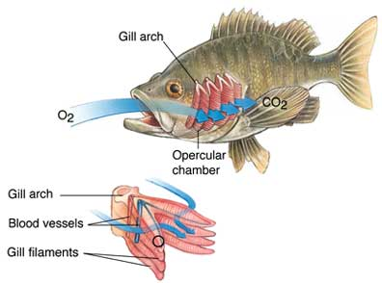
PISCES
Shark
These are fish.
They are exclusively aquatic animals.
Their skin is covered with scales/plates.
Tuna
Rohu
They obtain oxygen dissolved in water by using gills.
Scales/plates.
Eggs
The body is streamlined, and a muscular tail is used for movement.
They are cold-blooded and their hearts have only two chambers, unlike the four that humans have.
They lay eggs.
Some fish have entirely of cartilage, such as sharks
And some with a skeleton made of both bone and cartilage.

